Slide 1
Contactless Loyalty
Shouyi Cui
Notes:
Hello everyone,
This is contactless loyalty, my final year project about NFC.

Slide 2
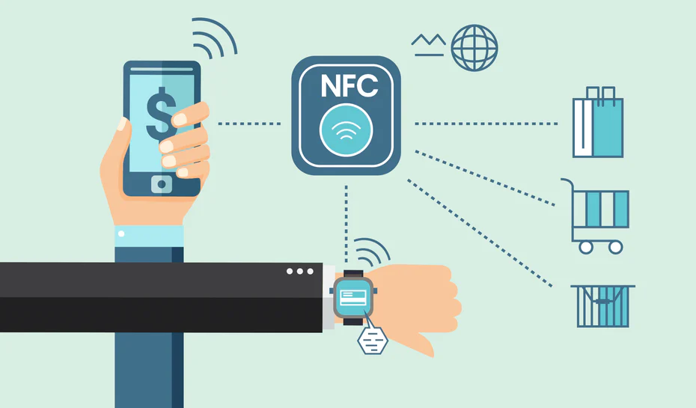
1. Why NFC Technology?
Find something you love to work on.
Notes:
First of all, why NFC? I chose this topic because it was something I really liked. I started to use Google Pay to pay very often and I was intrigued by how it worked and I questioned myself what else can this technology be used for?

Slide 3
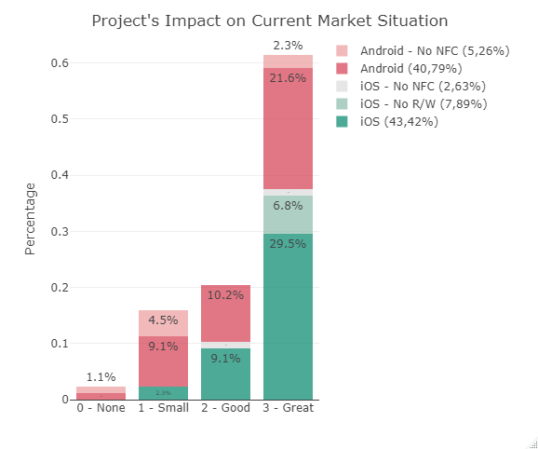
2. Would people use it?
Would you use it yourself?
Notes:
Secondly, I wondered if people would have used my application? Does it have meaning to exist? With the results of my survey I have found out that were many people interested. You can see about 79.5% of the people that responded in a positive manner towards my project implementation, so I went for it.

Slide 4
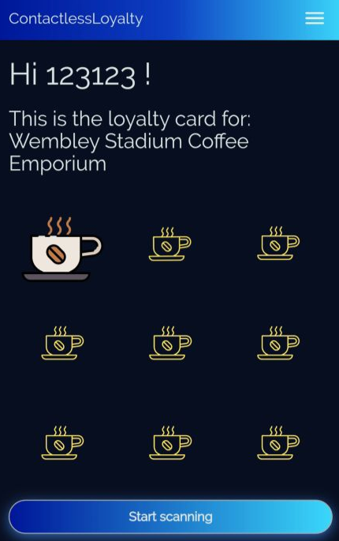
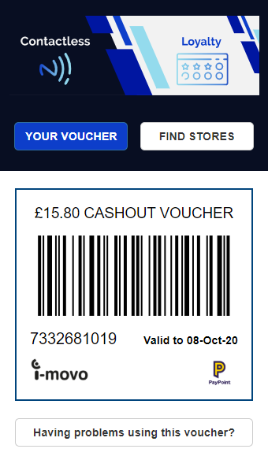
What is my work about?
Loyalty Scheme
Digital Vouchers
Easy Interaction
Notes:
Now, because I have worked in a placement year with a fintech company called i-movo, I was throw into the digital voucher economy. And that is where the loyalty part comes. The company I was working on were just providing the technology for a secure voucher, they were not offering any scheme but it was enough to lead me towards that direction.
Simple use case is:
I go to a coffee shop and buy an espresso
Because I have satisfied the loyalty scheme requirements, I am eligible for one point by scanning my phone to a NFC tag.
The cashier hands me the tag where I can scan
I scan it and the point is added in my user records
I have collected enough points for a free coffee and I click on the receive voucher button
I receive the voucher as URL by SMS
My initial idea was to create a software that would have automatically let you collect the rewards point within a shop when you were going to pay with a contactless application on the smartphone so that later on you could use an i-movo voucher. Then I realised it was going to be impossible because I would have needed to develop something like Google Pay but also to collaborate with many different shops and see how their till worked. There were too many outside factors in order to complete my idea therefore I changed to a version where I still could collaborate with i-movo, the company of my placement year but also work with the NFC.

Slide 5
What is new?
Web Application with NFC
Experimental feature developed by Google Chrome on trial during January to July 2020
Collaboration on GitHub with the creators
Using Microsoft Azure
Notes:
By the time I was going to develop, I found out about a new experimental feature released on Chromium browsers that would let Web Applications to use the NFC technology. I was excited and fascinated at the same time because that means that the solution would have been available cross platform, no need for the user install anything, update anything

Slide 6
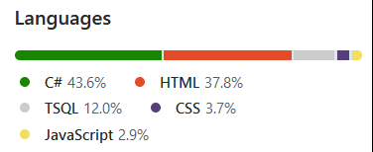
How did I create it?
Implementing
Testing
Fixing
Documenting
Notes:
Based on Github you can see the different languages used. In order to develop it I mostly followed this process of implementation, test, fix and document

